Slide 1
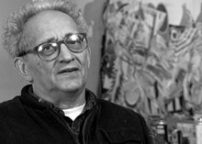
Frank Stella
BORN 1936
Notes:
(NOTE: This lesson requires class participation. When asking questions during the lesson, allow only 3 or 4 children to answer and move on.)
Hello Boys and Girls.
This is a picture of an American artist named Frank Stella.
Frank Stella was born in 1936 in Massachusetts. He first studied art in high school.
Then he studied history at Princeton University, which is in New Jersey.
After graduating from college, he moved to New York City and began working as an artist. He still lives and works in New York City today.

Slide 2
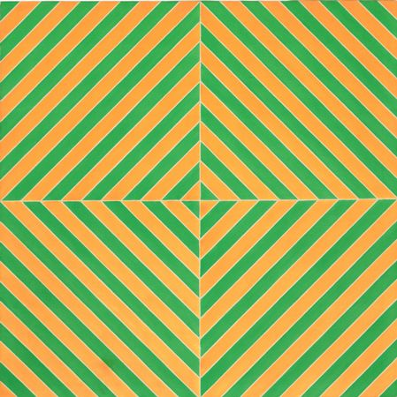
Fez (2), 1964
Museum of Modern Art, New York City
Notes:
Frank Stella is best known for creating paintings with geometric shapes like squares, circles and triangles. They also have bright colors and lines, like this one.
When asked if his paintings tell a story, Frank Stella answered, “What you see is what you see”.
So, what do YOU see in this painting? What shapes do you see? (Answer: Squares, diamonds, triangles, lines)
What colors do you see? (Answer: Green, orange)

Slide 3
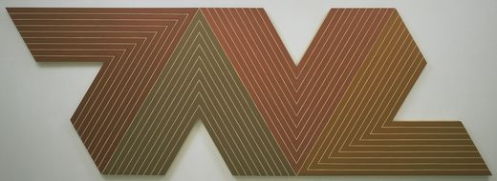
Empress of India, 1965
Museum of Modern Art, New York City
Notes:
What do YOU see in this painting? (Answer: The letter “V”)
How many “V”s do you see? (Answer: Four big ‘V’s, many different ‘V’s within each big ‘V’)
A painting is usually painted on a canvas. A canvas is a piece of fabric stretched over a wooden frame.
Most of the time, a canvas is shaped like a rectangle.
In this painting, Frank Stella shaped the canvas like the picture itself.
I need a volunteer to show us the shape of this canvas on the SmartBoard.
(PICK ONE STUDENT AND ASK HIM/HER TO TRACE THE OUTLINE OF THE PAINTING WITH HIS/HER FINGER.)

Slide 4
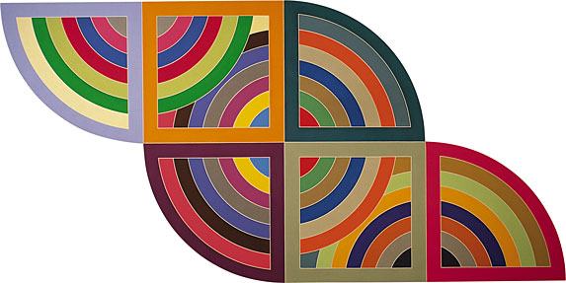
Harran II, 1967
Solomon R. Guggenheim Museum, New York City
Notes:
Frank Stella liked using bright colors in his paintings.
What colors do you see in this painting? (Prompt for creative answers like plum purple, lime green, hot pink, periwinkle blue)
He also liked using shiny metallic colors like gold and silver.
What shapes do you see in this painting? (Answer: Square, circle, half-circle, triangle with curved side)
I need another volunteer to show us the shape of this canvas on the SmartBoard.
(PICK ONE STUDENT AND ASK HIM/HER TO TRACE THE OUTLINE OF THE PAINTING WITH HIS/HER FINGER.)

Slide 5
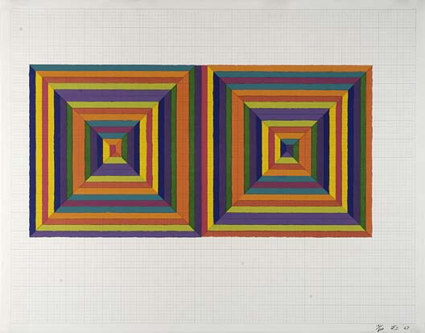
Fortin de las Flores,1967
Smithsonian American Art Museum, Washington D.C.
Notes:
What shapes do you see in this painting? (Answer: Squares, triangles)
Look closely at the middle of each square. Maybe you see two long, continuous hallways. Or a long, colorful string wrapping around and around.
Remember, “What you see is what you see.”
I need another volunteer to come up to the SmartBoard and show us the long string.
(PICK ONE STUDENT. ASK HIM/HER TO PLACE HIS/HER FINGER ON THE MIDDLE OF THE SQUARE ON THE RIGHT, THEN FOLLOW IT AROUND THE SQUARE.)

Slide 6
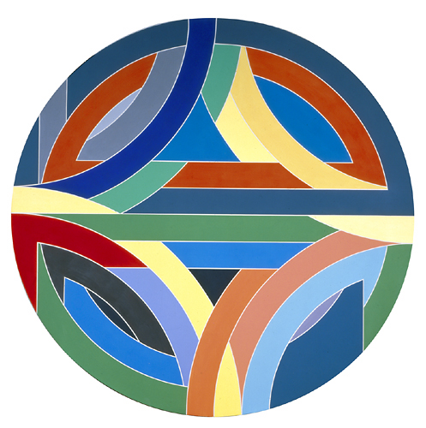
Sinjerli Variation IV, 1968
Wadsworth Atheneum Museum of Art, Hartford CT.
Notes:
Geometry is a kind of math that’s all about shapes like squares, triangles and circles.
(PASS AROUND ONE PROTRACTOR)
Now, I’m going to pass around a tool that’s used for geometry. It’s called a protractor. Do not bend it because it could break and cut you.
Geometry students use a protractor to learn about shapes.
Frank Stella used a protractor to make paintings of shapes. He even made painting s of protractors!
Do YOU see the protractors in this painting?
What is the shape of this canvas? (Answer: Circle)

Slide 7
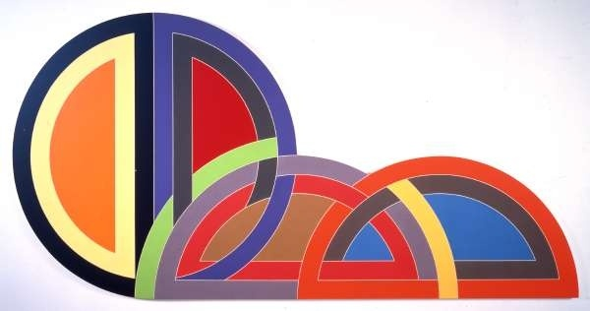
Ctesiphon I, 1968
Museum of Contemporary Art, Los Angeles, CA
Notes:
Look at all the protractors in this painting!
I need another volunteer to come up to the SmartBoard and show us the shape of this canvas.
(PICK ONE STUDENT AND ASK HIM/HER TO TRACE THE OUTLINE OF THE PAINTING WITH HIS/HER FINGER.)

Slide 8
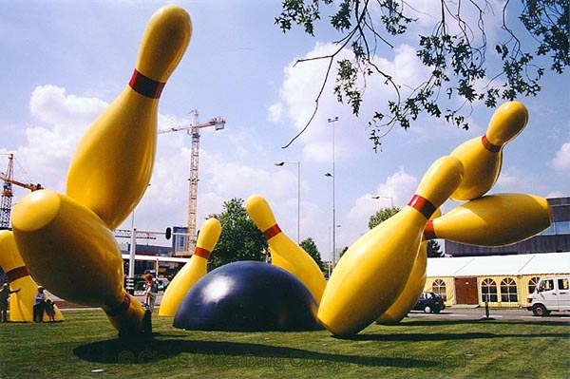
Frank Stella, Harran II
Claes Oldenburg, Flying Pins
Notes:
We learned about Claes Oldenburg’s (pronounced Klahss Old-en-berg) colossal sculptures earlier in the school year.
How are Frank’s Stella paintings and Claes Oldenburg’s sculptures alike?
(Prompt for answers: They’re both colorful, they’re both fun, they don’t tell a story.)
How are Frank’s Stella paintings and Claes Oldenburg’s sculptures different?
(Prompt for answers: One is a painting, one is a sculpture. You have to go to a museum to see the painting, but the sculpture is outside where everyone can see it. The painting is flat, the sculpture is 3-D. )

Slide 9
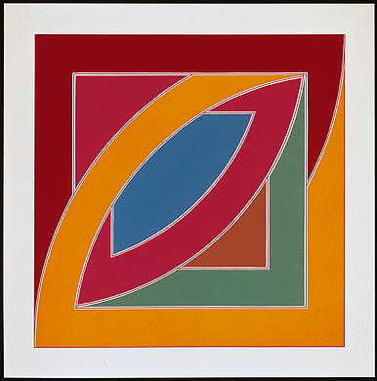
River of Ponds II, 1971
National Gallery of Art, Washington D.C.
Notes:
Let’s talk about the colors in this painting.
In a big box of crayons, every crayon has a name on the label.
What would you name the red color in this painting? (Possible answers: Brick red, clay red)
What would you name the orange color in this painting? (Possible answers: Cheddar cheese, golden orange)
Did you enjoy seeing these Frank Stella paintings?
Which one did you like the best?
(FLIP THROUGH THE SLIDES. WHEN THE STUDENTS REACT TO ONE, ASK “What do you like the best about this painting?” KEEP IT DISPLAYED AND GO TO LESSON.)

Slide 10
